Slide 1
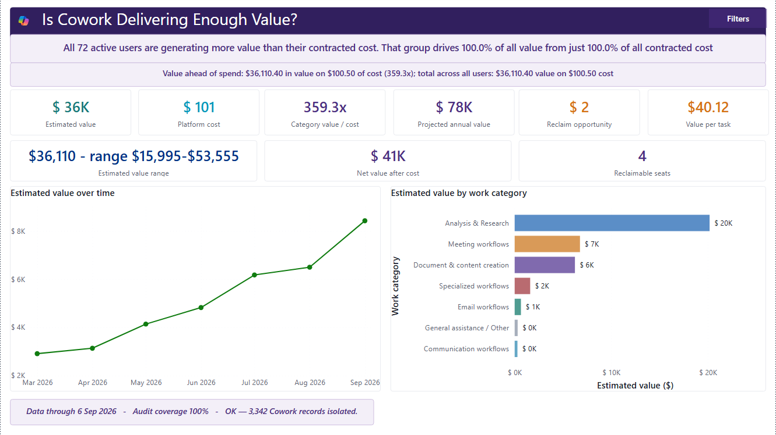
IN TESTING | INTERPRETATION GUIDE
Cowork
Value Intelligence
A detailed operating guide for observed work, modeled value, consumption, allocation, and defensible action.
Current Cowork Value executive summary
From source evidence to an owned decision.
Fabricated sample data | @example.com identities

Slide 2
Agenda
Orientation, page walkthroughs, methodology, and operating boundaries
Orient
Read
1
2
Choose the decision and the evidence path before reading a KPI.
Use the same five-layer page walkthrough for every view.
Challenge
Act
3
4
Inspect assumptions, allocation rules, and missing dependencies.
End with an owner, source check, guardrail, and next step.
llorenz28/cowork-value-intelligence
In Testing | Fabricated sample data

Slide 3
What this guide adds
The report exposes its evidence, assumptions, and interpretation boundaries
F
FRIENDLY SKILL LABELS
V
VALUE SCOPE CONTROL
T
TRANSPARENT ASSUMPTIONS
Curated names appear where known; technical identifiers fall back to readable labels without changing classification.
Verified-only and broader representative scenarios keep uncertain action mappings visible instead of silently valuing them.
Category minutes, labor rate, billing mode, price inputs, and quality adjustments remain visible and challengeable.
A
ALLOCATION BOUNDARIES
P
POPULATION GATES
D
DECISION LANGUAGE
Per-skill, department, and model costs are directional allocations unless the source supplies matching metering.
User tiers and related comparisons stay unavailable until the filtered population supports the method.
Every view pairs a next action with wording that stays inside the evidence the report actually contains.
llorenz28/cowork-value-intelligence
In Testing | Fabricated sample data

Slide 4
Five-minute orientation
If time is limited, read these four pages in order
Start Here
Choose the decision path and confirm required inputs.
1
Executive Summary
Read observed activity before modeled value and cost.
2
Methodology & Value Calculator
Inspect the selected assumptions and sensitivity.
3
Glossary
Carry the metric definition and evidence label into the decision.
4
llorenz28/cowork-value-intelligence
In Testing | Fabricated sample data

Slide 5
Evidence model at a glance
Required activity flows through derived facts; optional inputs add context and cost
Purview audit
Cowork usage
Organization
Consumption
Required event evidence
Optional aggregate reconciliation
Optional department and business unit context
Optional observed credits and recency
Source evidence
Derived task, user, category, recency, and reconciliation facts
Modeled value and directional allocations
BOUNDARY
The usage export is aggregate evidence. It must never manufacture an event timeline or replace missing Purview detail.
llorenz28/cowork-value-intelligence
In Testing | Fabricated sample data

Slide 6
Different evidence requires different wording
Use the label that matches the metric's actual evidence condition
OBSERVED
Direct source count
The connected export contains...
DERIVED
Arithmetic over observed fields
The report calculates...
MODELED
Observed activity plus assumptions
Under the selected assumptions...
ALLOCATED
A total distributed without source metering
The modeled allocation suggests...
UNAVAILABLE
A required dependency is absent
This cannot be calculated yet.
llorenz28/cowork-value-intelligence
In Testing | Fabricated sample data

Slide 7
SECTION 1
Page-by-page walkthrough
Read every page in five layers: purpose, reading order, diagnostic question, action, and guardrail.
Observed signals. Transparent assumptions. Defensible decisions.

Slide 8
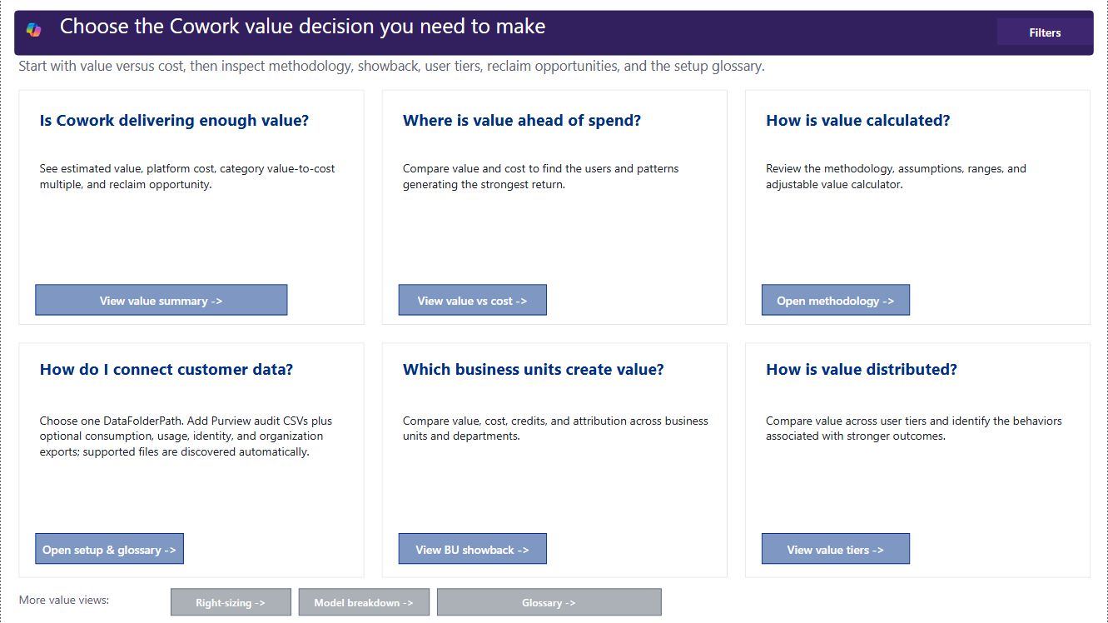
Start Here
1 of 12 report pages
P
PURPOSE
Route each value, cost, distribution, or setup question to the page with the right evidence.
R
READ
Choose the decision first, then confirm that the required source files and customer inputs are available.
D
DIAGNOSE
Which business question must be answered now, and which page owns that question?
I
INTERPRET
A page can still be useful when optional organization or consumption inputs are absent.
Current Power BI capture | deterministic fabricated sample data
ACTION
Open one path and verify its source-status notes before quoting any number.
GUARDRAIL
Do not treat modeled value, observed credits, allocated cost, and invoice chargeback as interchangeable.
llorenz28/cowork-value-intelligence
In Testing | Fabricated sample data

Slide 9
Executive Summary
2 of 12 report pages
P
PURPOSE
Summarize observed activity, modeled value, effective cost, return, and assumption status.
R
READ
Read active users and task volume before modeled hours, value, effective platform cost, and ROI.
D
DIAGNOSE
Are the headline results complete, reconciled, and supported by current customer inputs?
I
INTERPRET
A favorable return is conditional on time, labor, billing, and price assumptions.
Current Power BI capture | deterministic fabricated sample data
ACTION
Confirm reconciliation and Finance-approved inputs before sharing the headline.
GUARDRAIL
Do not present scenario ROI as causality, audited savings, or realized cash return.
llorenz28/cowork-value-intelligence
In Testing | Fabricated sample data

Slide 10
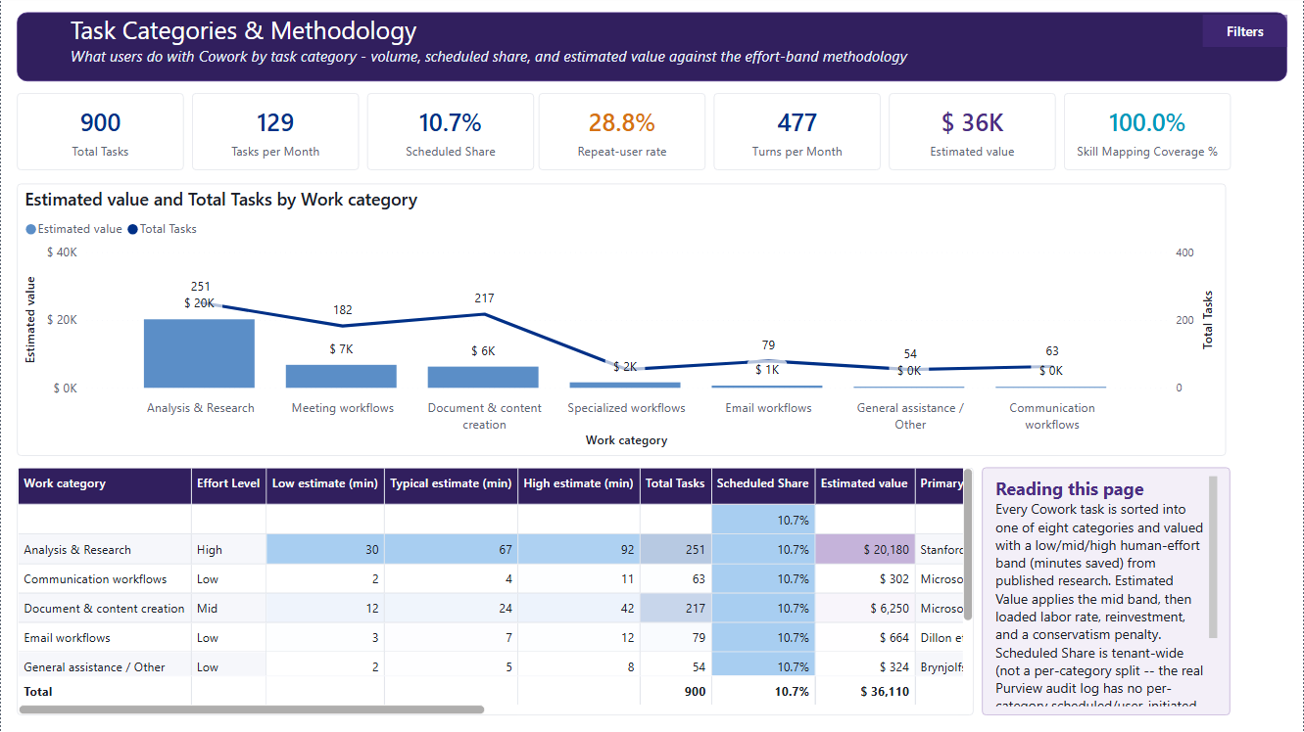
Task Categories & Methodology
3 of 12 report pages
P
PURPOSE
Show observed work by category and the minute benchmarks that produce modeled value.
R
READ
Read task volume, mapping coverage, scheduled share, and the selected low, mid, or high benchmark.
D
DIAGNOSE
Which categories drive the result, and how much is explained by benchmark choice?
I
INTERPRET
Minutes saved are published assumptions applied to observed tasks, not measured task duration.
Current default viewport | scrollable methodology table continues beyond the visible rows
ACTION
Review source citations and the hidden assumptions page before changing a benchmark.
GUARDRAIL
Do not compare categories without carrying their task count, effort band, and selected estimate basis.
llorenz28/cowork-value-intelligence
In Testing | Fabricated sample data

Slide 11
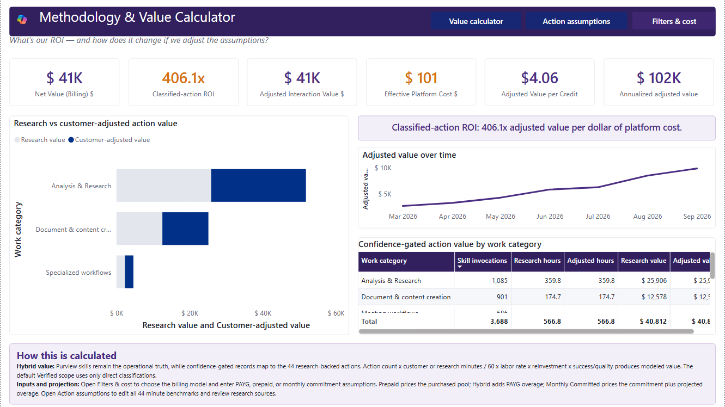
Methodology & Value Calculator
4 of 12 report pages
P
PURPOSE
Make the value formula, customer inputs, sensitivity range, and selected adjustments visible.
R
READ
Read baseline value, adjusted value, platform cost, and return together with the selected controls.
D
DIAGNOSE
Which input moves the conclusion most, and is that input approved by its business owner?
I
INTERPRET
Low, mid, and high outputs are assumption scenarios, not statistical confidence intervals.
Current default viewport | scrollable category table continues beyond the visible rows
ACTION
Record the estimate basis, labor rate, adjustments, billing mode, and price inputs with every result.
GUARDRAIL
Do not share a dollar result without its period, filters, evidence label, and assumption set.
llorenz28/cowork-value-intelligence
In Testing | Fabricated sample data

Slide 12
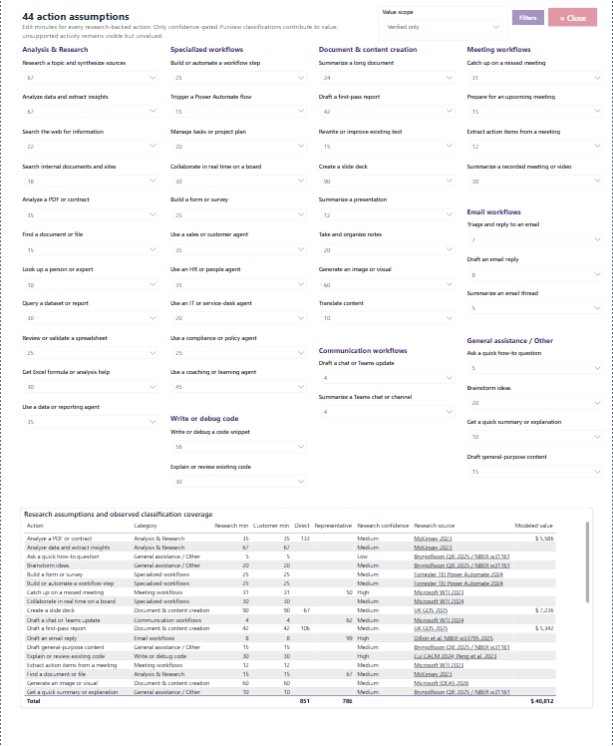
Action Assumptions
5 of 12 report pages | hidden operational page
P
PURPOSE
Maintain the action taxonomy, benchmark minutes, evidence citations, and representative mappings.
R
READ
Review action name, category, effort band, low-mid-high estimates, and source citation as one record.
D
DIAGNOSE
Does each valued action have a defensible category, estimate, source, and mapping confidence?
I
INTERPRET
Changes affect modeled hours, value, net value, and ROI across every visible page.
Hidden operational page | current 44-action assumption catalog
ACTION
Document and approve changes before exporting or presenting affected results.
GUARDRAIL
Do not assign value to ambiguous or unclassified records merely to increase coverage.
llorenz28/cowork-value-intelligence
In Testing | Hidden assumptions page | Fabricated sample data

Slide 13
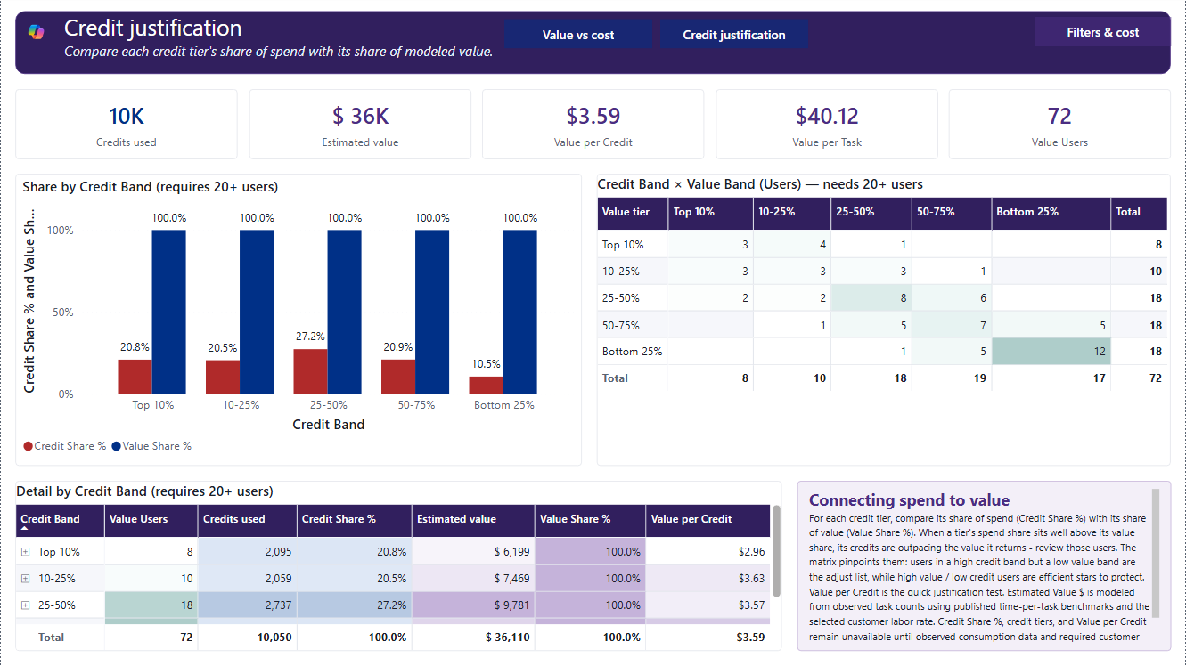
Value vs Cost
6 of 12 report pages
P
PURPOSE
Compare modeled value with customer-priced observed consumption under the selected billing mode.
R
READ
Confirm billing mode and required inputs before adjusted value, effective cost, net value, and ROI.
D
DIAGNOSE
Does the conclusion hold when the cost basis and value assumptions are changed?
I
INTERPRET
Positioning is scenario-based; cost is not an invoice unless backed by matching billing records.
Current default viewport | scrollable detail and interpretation panels continue in the report
ACTION
Re-run with Finance-approved terms and inspect band-level outliers before making a decision.
GUARDRAIL
Do not infer productivity or causality from a favorable value-to-cost ratio.
llorenz28/cowork-value-intelligence
In Testing | Fabricated sample data

Slide 14
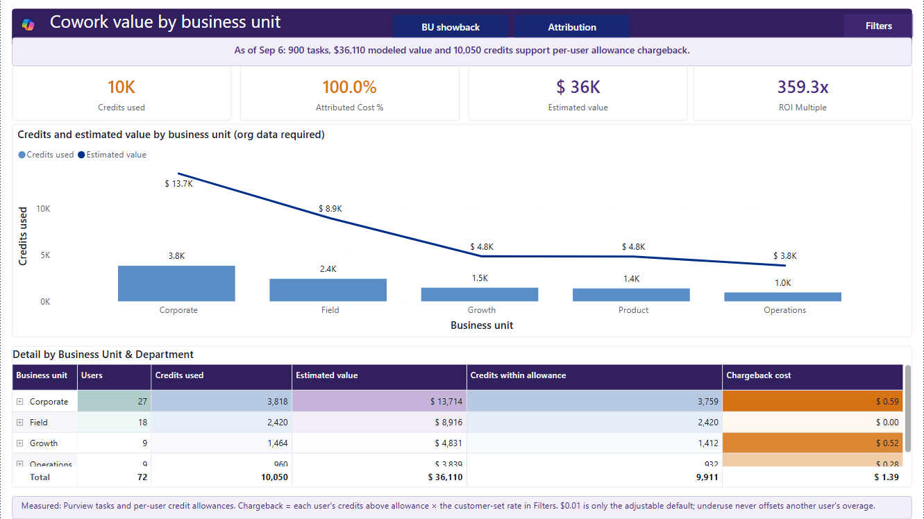
Value by Department
7 of 12 report pages
P
PURPOSE
Distribute observed tasks, credits, modeled value, and allocated cost across business units.
R
READ
Check organization-match coverage before comparing tasks, value, credits, and cost separately.
D
DIAGNOSE
Are differences driven by work mix, population size, consumption, or incomplete identity matching?
I
INTERPRET
Department cost follows the documented allocation rule and is not a ledger charge.
Current default viewport | scrollable department table continues beyond the visible rows
ACTION
Reconcile ownership and identity coverage with the authorized organization-data owner.
GUARDRAIL
Do not rank departments without population, role, seasonality, and work-category context.
llorenz28/cowork-value-intelligence
In Testing | Fabricated sample data

Slide 15
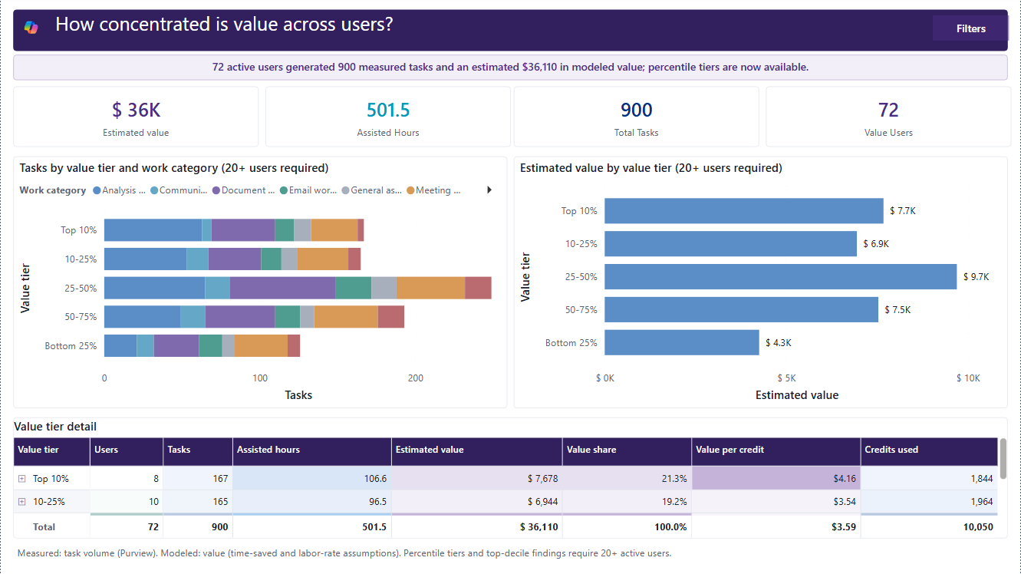
Value by User Tier
8 of 12 report pages
P
PURPOSE
Show how task activity, assisted time, and modeled value concentrate across active users.
R
READ
Read tier population, task share, modeled value share, and user detail together.
D
DIAGNOSE
Does concentration reflect champions, dependency, uneven enablement, or a filtered population effect?
I
INTERPRET
Percentile tiers require at least 20 active users and are relative to the current filter context.
Current Power BI capture | deterministic fabricated sample data
ACTION
Pair the tier with role, department, work category, and seasonality before targeting enablement.
GUARDRAIL
Tiers are not employee-performance ratings and must not be used for personnel action.
llorenz28/cowork-value-intelligence
In Testing | Fabricated sample data

Slide 16
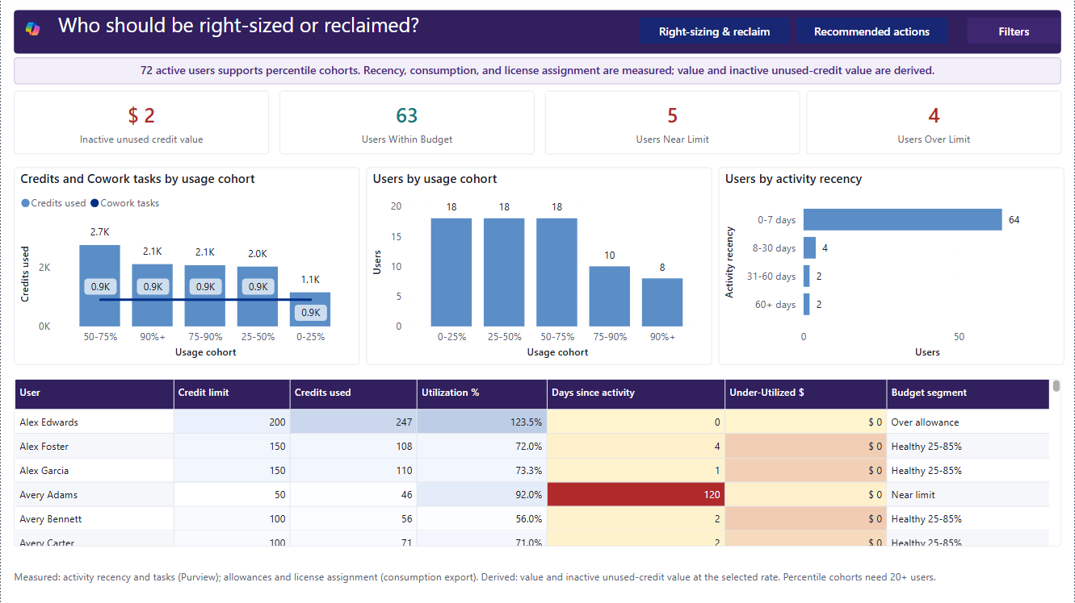
Right-Sizing & Reclaim
9 of 12 report pages
P
PURPOSE
Identify near-limit, over-limit, inactive, and under-utilizing usage patterns for review.
R
READ
Read observed credits, allowance, activity recency, and budget segment within the same period.
D
DIAGNOSE
Is the pattern explained by role, leave, seasonality, contract terms, or stale data?
I
INTERPRET
A budget or recency flag is a review prompt, not an automatic license decision.
Current default viewport | scrollable user table continues beyond the visible rows
ACTION
Confirm manager context and customer terms before changing access, allowance, or assignment.
GUARDRAIL
Reclaim dollars remain unavailable without source-backed assignment and customer seat-price data.
llorenz28/cowork-value-intelligence
In Testing | Fabricated sample data

Slide 17
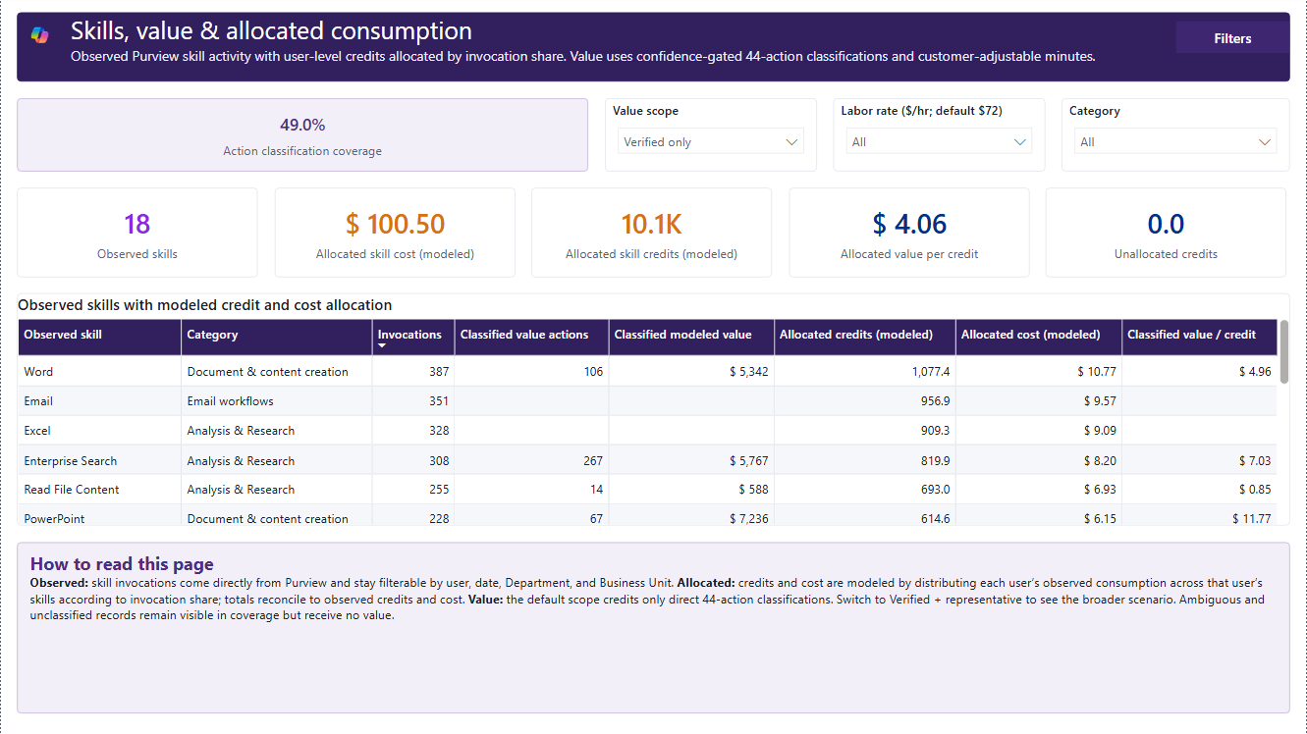
Skills & Allocated Consumption
10 of 12 report pages
P
PURPOSE
Connect observed skill volume with a directional allocation of credits, cost, and classified value.
R
READ
Read invocation count and friendly skill label first, then mapping coverage and allocated outputs.
D
DIAGNOSE
Which skills are observed most, and how much of their activity has a defensible value classification?
I
INTERPRET
Friendly labels improve readability; they do not change mapping, category, or value treatment.
Current Power BI capture | deterministic fabricated sample data
ACTION
Use observed skill volume for enablement; use allocated consumption only as directional planning context.
GUARDRAIL
The source does not meter credits or value per skill, so repeated parent values must not be summed.
llorenz28/cowork-value-intelligence
In Testing | Fabricated sample data

Slide 18
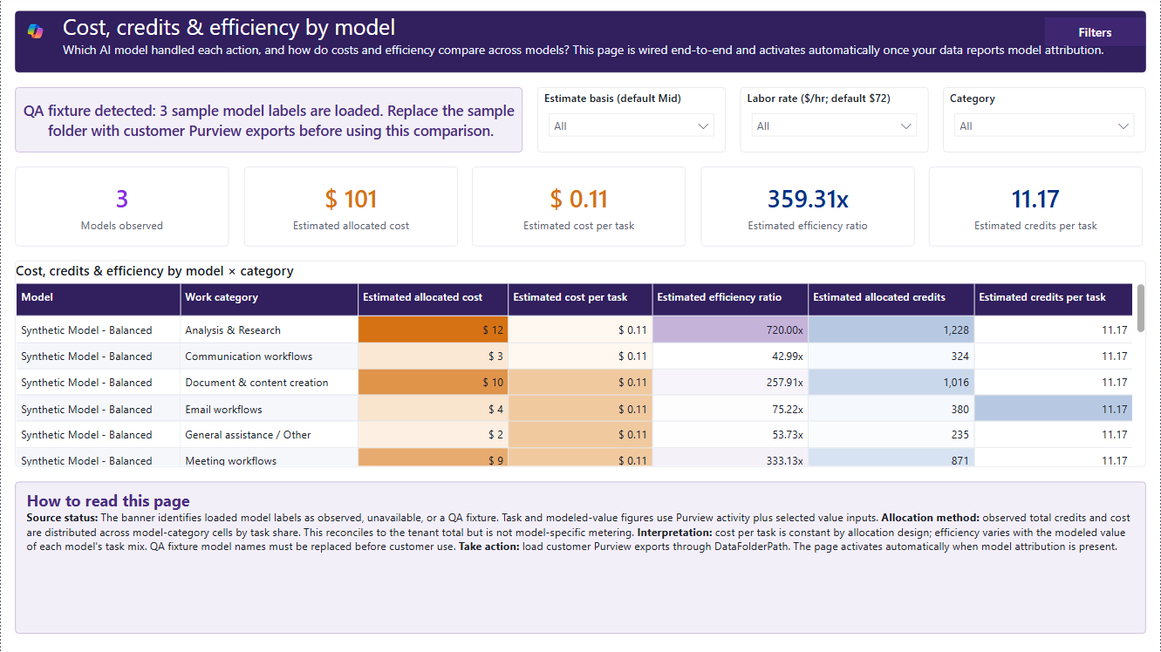
Model & LLM Breakdown
11 of 12 report pages
P
PURPOSE
Show source-attributed model activity and the directional allocation that follows from task share.
R
READ
Confirm model names are present in Purview before reading allocated cost, credits, or efficiency.
D
DIAGNOSE
Is the model label source-backed, and is there model-specific metering for the decision?
I
INTERPRET
Allocated cost and efficiency cannot prove that one model is cheaper or more productive.
Current Power BI capture | deterministic fabricated sample data
ACTION
Obtain source-backed per-model metering before making model selection or cost recommendations.
GUARDRAIL
If model data is unavailable, stop; do not infer or fabricate a model label.
llorenz28/cowork-value-intelligence
In Testing | Fabricated sample data

Slide 19
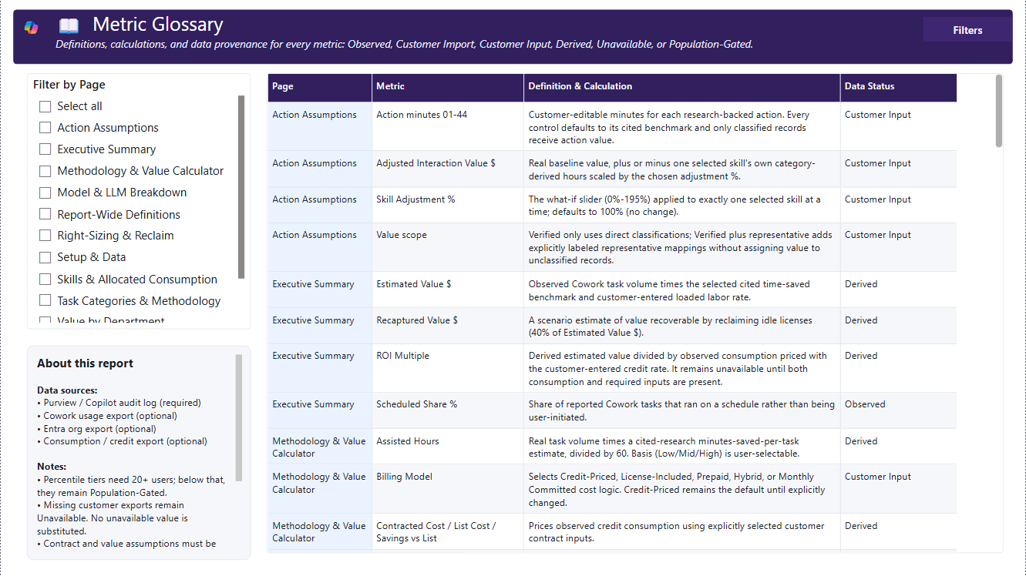
Glossary
12 of 12 report pages
P
PURPOSE
Define each metric and disclose its evidence label, source dependency, calculation, and limitation.
R
READ
Use the definition and data status together; unavailable does not mean zero.
D
DIAGNOSE
Can a reviewer reproduce the metric from the listed source and calculation?
I
INTERPRET
Modeled and allocated results must travel with their assumptions and allocation basis.
Current Power BI capture | deterministic fabricated sample data
ACTION
Copy the definition, period, filters, evidence label, and selected inputs into the decision record.
GUARDRAIL
Do not rename a metric in a way that overstates what the source evidence proves.
llorenz28/cowork-value-intelligence
In Testing | Fabricated sample data

Slide 20
SECTION 2
Methodology and operating controls
Understand the formulas, billing modes, allocation rules, source checks, and documentation required behind the visuals.
Observed signals. Transparent assumptions. Defensible decisions.

Slide 21
Methodology | Modeled value
Observed task volume multiplied by explicit, customer-reviewable assumptions
Assisted hours = sum(category task threads x selected category minutes saved) / 60
Estimated value = assisted hours x loaded labor rate
O
OBSERVED
S
SELECTED
Task threads and category assignment from approved source evidence.
Low, mid, or high minutes-saved benchmark for each category.
C
CUSTOMER INPUT
O
OUTPUT
Loaded labor rate and optional reinvestment, quality, or skill adjustments.
A scenario estimate whose value changes when the assumptions change.
LANGUAGE
Say 'under the selected assumptions' and carry the estimate basis, labor rate, period, and filters with the result.
llorenz28/cowork-value-intelligence
In Testing | Fabricated sample data

Slide 22
Methodology | Billing and allocation
Five planning modes keep value, cost, and consumption concepts separate
Credit-Priced
Observed credits x customer credit price
O
OBSERVED
Credits used, active users, activity recency, task threads, and source attributes when available.
License-Included
Customer seat price or contracted cost
M
MODELED
Prepaid
Committed amount within the selected period
Assisted hours, estimated value, adjusted value, return, and forecast outputs.
Hybrid
Base commitment plus qualified overage
A
ALLOCATED
Monthly Committed
Monthly commitment compared with observed use
Department, skill, or model cost distributed by a documented rule without direct source metering.
BOUNDARY
Allocation supports planning and showback. It is not an invoice, ledger charge, or source-measured chargeback unless the source explicitly supplies that evidence.
llorenz28/cowork-value-intelligence
In Testing | Fabricated sample data

Slide 23
Data pipeline | Inputs and validation
Local and SharePoint editions use the same logical contract
1
Collect
Export approved Purview activity plus any optional usage, organization, and consumption files.
2
Place
Use one protected local folder or the configured SharePoint folder path.
3
Refresh
Confirm source discovery, schema compatibility, and freshness before reading KPIs.
4
Reconcile
Compare task, user, credit, and identity totals against the source exports.
5
Document
Record period, filters, assumptions, unavailable dependencies, and the output owner.
SECURITY
Keep customer exports in approved protected storage. Review every screenshot, video, PDF, and export for identifiers before sharing.
llorenz28/cowork-value-intelligence
In Testing | Fabricated sample data

Slide 24
Defensible decision language
End with the evidence, the boundary, and an owned next step
"Under the selected category-minute and labor-rate assumptions, the observed task volume models to..."
VALUE
"Using the selected billing mode and customer-approved price inputs, effective platform cost is..."
COST
"The directional allocation suggests concentration in..., but source metering is not available at this grain."
ALLOCATION
"The current period flags this account for review; role, leave, seasonality, and contract terms still require validation."
RIGHT-SIZING
Decision record minimum: metric definition | evidence label | period | filters | assumptions | owner | next validation step
llorenz28/cowork-value-intelligence
In Testing | Decision support, not billing or personnel evidence

